Slide 1
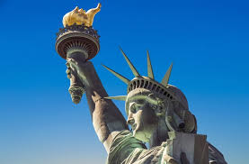
The Economics of Immigration
SIRS, #47, San Rafael, CA
January 25, 2022
Jon Haveman, Ph.D.
Executive Director, NEED

Slide 2
National Economic Education Delegation
Vision
One day, the public discussion of policy issues will be grounded in an accurate perception of the underlying economic principles and data.
Mission
NEED unites the skills and knowledge of a vast network of professional economists to promote understanding of the economics of policy issues in the United States.
NEED Presentations
Are nonpartisan and intended to reflect the consensus of the economics profession.

Slide 3
Who Are We?
Honorary Board: 54 members
2 Fed chairs: Janet Yellen, Ben Bernanke
6 chairs of the Council of Economic Advisers
Furman (D), Rosen (R), Bernanke (R), Yellen (D), Tyson (D), Goolsbee (D)
3 Nobel prize winners
Akerlof, Smith, Maskin
Delegates: 645+ members
At all levels of academia and some in government service
All have a PhD in economics
Crowdsource slide decks
Give presentations
Global Partners: 48 PhD Economists
Aid in slide deck development

Slide 4
Available NEED Topics Include:
US Economy
Climate Change
Economic Inequality
Economic Mobility
US Social Policy
Trade and Globalization
Minimum Wages
Immigration Economics
Housing Policy
Federal Budgets
Federal Debt
Black-White Wealth Gap
Autonomous Vehicles

Slide 5
Credits and Disclaimer
This slide deck was authored by:
Anna Maria Mayda, Georgetown University
Robert Gitter, Ohio Wesleyan University
Roger White, Whittier College
This slide deck was reviewed by:
Kirk Doran, Notre Dame
Ethan Lewis, Dartmouth College
Disclaimer
NEED presentations are designed to be nonpartisan.
It is, however, inevitable that presenters will be asked for and will provide their own views.
Such views are those of the presenter and not necessarily those of the National Economic Education Delegation (NEED).

Slide 6
Outline
What is immigration and why do people migrate?
History of immigration to the US
Economics of immigration

Slide 7
What Is Immigration?
Immigration
The action of coming to live in another country.
Emigration
The act of leaving one’s own country and going to live in another country.

Slide 8
Why Do People Migrate?
Push factors:
Economic dislocation, violence, population pressures, religious persecution, or denial of political rights.
Pull factors:
Potential for higher wages, job opportunities, and political or religious liberty, family unification.
Uneven development:
Disparities in income, standards of living, and the availability of jobs within and across societies.
Source: Gilder Lehrman Institute of American History.

Slide 9
Historical Trends in Authorized Immigration
https://www.libertyellisfoundation.org/immigration-timeline
Notes:
1989-1991: 1986 Immigration Reform and Control Act – naturalization of unauthorized immigrants who had arrived prior to 1986 and Immigration Act of 1990 more than doubled the entry cap for authorized immigration.

Slide 10
Authorized Immigration by Region

Slide 11
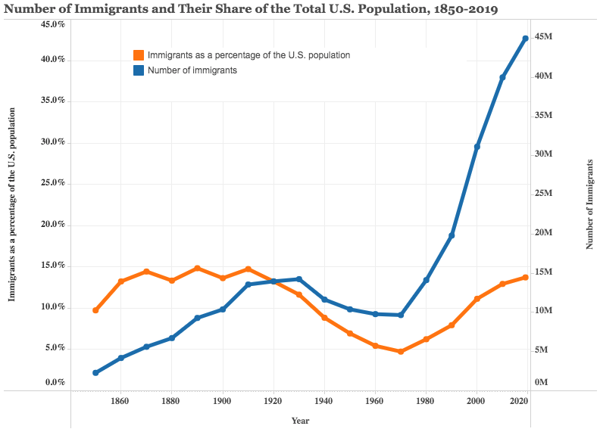
https://www.migrationpolicy.org/programs/data-hub/us-immigration-trends#history

Slide 12
Immigrant Population in 2017
Categories of the total number
of immigrants in the United States.
https://www.pewresearch.org/fact-tank/2019/07/12/how-pew-research-center-counts-unauthorized-immigrants-in-us/

Slide 13
U.S. Unauthorized Immigration: Labor Force
Pew Research Center, 5 facts about illegal immigration in the U.S., June 12, 2019

Slide 14
Unauthorized Immigration: 2012-2016
https://www.migrationpolicy.org/programs/data-hub/charts/unauthorized-immigrant-populations-country-and-region-top-state-and-county
Notes:
3/11 million of unauthorized immigrants live in CA

Slide 15
Why Do We Care? Economic Implications
GDP
Labor markets
Government revenue and spending
Crime

Slide 16
GDP: How Does This Work?
What determines the size of an economy?
Technology/productivity
Physical capital
The number of workers
Immigration adds to the number of workers.
Number of immigrants in the labor force is high
28.2 million foreign-born persons ages 16+ in the labor force in 2018.
17.4% of the total US workforce (little less than 5% unauthorized)
Evidence
Immigrants added 11% to GDP ($2 trillion) in 2016.

Slide 17
Immigration: One Way to Grow the Labor Force
Civilian Labor Force Growth is Slowing

Slide 18
Labor Market Implications: The Surplus
The Surplus
Immigration CAN make all native-born workers and capital more productive.
This increases incomes of the native born.
In other words, the economy might not just get bigger, it might become more productive as well!
This will, on average, increase the living standards of all native-born workers and owners of capital.

Slide 19
Labor Market Implications: Complicated
Depends on the type of immigrant: Skills/education
Similar to native-born population - Immigration surplus?
Low-skilled - increases immigration surplus!
Highly skilled - increases immigration surplus!
In the long-run: Brings capital market implications
Expansion of capital stock through increased investments in equipment etc.
Source: Hong & McLaren (2015).
Notes:
Immigration surplus arises when native wages fall as a result of immigration . Losses in wages are offset by income accruing to capital owners. The greater the differences in terms of skills of immigrants relative to native workforce, the greater the disruption to labor markets and the greater is the opportunity for native born labor and owners of capital.

Slide 20
Labor Market Implications: General Principles
Short run
Harm likely to native-born workers who are similar to immigrants.
Benefit likely for other workers and owners of capital.
Long run
Expanded opportunities may restore wages of harmed native-born workers.
Lower prices in some areas will restore purchasing-power of harmed workers and others.
Inflows of other types of labor and capital may return the economy to its pre-immigration wage structure and production patterns.
Note: Repeated short run shocks can make the medium and long run look like the short run.

Slide 21
Consensus among Economists
97% of economists agree – or agree with provisos:
immigration generally has a net positive economic effect for the US economy.
64% of economists agree:
immigration will NOT depress the average wage rate in the US.
Source: Geide-Stevenson, LaParraPerez, (2021)

Slide 22
Recent Immigrants Are Less and More Educated

Slide 23
Skilled Immigrants and Innovation
1% increase in the share of the immigrant college graduate population
9-18% increase in patenting per capita
Increased immigration increases patenting by native-born population
In the 1990s
Increased skilled immigration can account for one-third of increased patenting in that decade.
This translates into a 1.4-2.5% increase in GDP per capita by the end of the decade.

Slide 24
Immigrants and Entrepreneurship
Self-Employment Rates by Nativity
Source: Magnus Lofstrom from Current Population Survey Data.

Slide 26
Fortune 500: First- and Second-Generation Founders

Slide 27
Government Revenues versus Expenditures
Basic Question:
What are the taxes (income, sales, and other) immigrants pay vs. government expenditures on public benefits and services they receive.
More complicated:
Immigrants also affect the fiscal equation for many native-born residents.
Indirectly through labor and capital markets.
Changes in wages and the return to capital.

Slide 28
What Do We Know?
Immigrants who arrive while of working age:
Are, on average, net contributors.
21-year-old with a high school diploma: +$126,000 over a lifetime
Though this value gradually declines with age at arrival.
Turns negative for arrivals of age 35+
Net contribution crucially depends on characteristics
Age distribution, family composition, health status, fertility patterns
Temporary or permanent relocation
Employment in the legal labor market
Authorized or unauthorized

Slide 29
Implications for Major Federal Programs
Documented immigrants are less likely to use Social Security and Medicare.
Unauthorized immigrants are ineligible.
They will (may) pay into the system but cannot receive benefits.
Medicaid: not available to legal residents for the first five years.
Provide a source of revenue for an aging population.

Slide 30
Implications for Social Security
Population Age 65+ per 100 of Working Age (25-64)
Source: Blau & Mackie (2017).
Notes:
Average age of US population increases and the birthrates are the lowest they have been in decades. Background of a slowing birthrates around the globe.

Slide 31
Bottom Line/Consensus of Estimates
FEDERAL level: fiscal impact is generally positive.
STATE AND LOCAL level: typically negative fiscal impact.

Slide 32
Immigrants and Crime Rates
Conventional wisdom:
Immigrants commit crimes more frequently than do native born residents.
Rising immigration leads to rising crime.
What do the data say?
Rates of incarceration are lower for the foreign born than US born.
Neighborhoods with more immigrants have lower crime rates.
There is no evidence that deporting noncitizen immigrants affects crime rates.

Slide 33
Crime: Incarceration Rates in California
California Institutionalization Rate
U.S.-Born and Foreign-Born Men Ages 18-40, by Place of Birth
Source: Butcher & Piehl (2008).

Slide 34
Summary
Immigration should be thought of as increasing the population of the United States.
This brings economic growth and opportunity, just as does increasing the native-born population.
Including unauthorized immigrants, the supply of low-skilled workers is increased
This lowers the wages of low-skilled workers.
But also increases labor force participation among highly skilled workers.

Slide 35
About Conventional Wisdom
Native-born unskilled workers
There is some negative impact on their wages.
But who wins and loses depend on the skill mix of immigrants;
when this skill mix changes, so do its effects.
Crime
Immigrants, both authorized and unauthorized, commit crimes at much lower rates than do native-born residents.
Government programs
Federal: immigrants are a source of revenue and stability for some important programs.
State and local: because education is funded at the local level, this can be a drain on local government coffers.

Slide 36
Thank you!
Any Questions?
www.NEEDelegation.org
Jon Haveman
Jon@NEEDelegation.org
Contact NEED: info@needelegation.org
Submit a testimonial: www.NEEDelegation.org/testimonials.php
Become a Friend of NEED: www.NEEDelegation.org/friend.php

